Slide 1

Von-Neuman architecture
Computer Organization and Architecture | Register Organization
Computer Organization and Architecture | Chapter: Register Organization | Bachelor of Engineering
DISCOVER · LEARN · EMPOWER
Notes:
Welcome everyone to today's lecture on Von-Neuman architecture within our Register Organization chapter. This foundational concept explains how registers and memory interact in a unified system. We will explore the structural implications of this design on modern computing. Remember, understanding this is key to analyzing instruction set architectures effectively.

Slide 2
Course Outcomes
SLIDE 2 / 14
Course Outcome
CO | BT LEVEL | DESCRIPTION
CO1 | BT3 | Apply number systems and digital logic to design basic digital circuits
CO2 | BT4 | Analyze register organization and instruction set architecture
CO3 | BT3 | Implement computer arithmetic algorithms and floating-point operations
CO4 | BT5 | Analyze memory hierarchy and input-output organization
CO5 | BT6 | Evaluate control unit design and pipelining performance
Chandigarh University
2 / 14
Notes:
Today's lecture directly addresses Course Outcome 2, which requires you to analyze register organization. We will focus specifically on how the Von-Neuman architecture dictates the flow of data through registers. This analysis is crucial for understanding the instruction set architecture's limitations and capabilities. By the end, you will be able to evaluate this architecture critically.

Slide 3
Learning Objectives
SLIDE 3 / 14
Learning Outcomes
1
Define the core components of Von-Neuman architecture and their roles.
2
Analyze the shared bus mechanism connecting registers and memory.
3
Evaluate the impact of the Von-Neuman bottleneck on performance.
4
Differentiate between instruction and data storage in a unified memory.
5
Apply the architecture to solve a basic register transfer problem.
Chandigarh University
3 / 14
Notes:
By the end of this session, you will be able to define the core components and their specific roles in the system. You will analyze how the shared bus connects registers and memory, creating a potential bottleneck. We will evaluate the performance impact of this design and differentiate between how instructions and data are stored. Finally, you will apply these concepts to solve a basic register transfer problem.

Slide 4
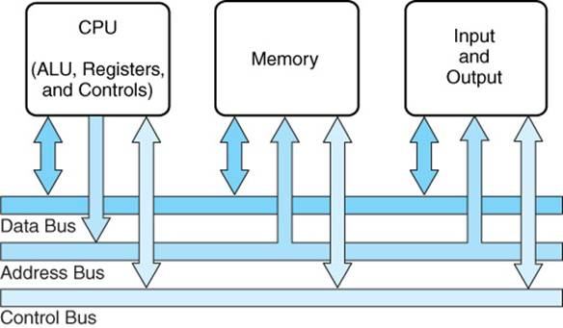
Lecture
SLIDE 4 / 14
Core Components Definition
1
The architecture uses a single shared bus for all data transfers.
2
Memory stores both instructions and data in a unified address space.
3
The Control Unit fetches instructions sequentially from the main memory.
4
The Arithmetic Logic Unit performs operations on data from registers.
5
Registers act as high-speed storage for immediate CPU operations.
6
The Program Counter tracks the address of the next instruction.
The System Bus
Chandigarh University
4 / 14
Notes:
The defining feature here is the single shared bus that connects all components. This means memory stores both instructions and data in a unified address space, unlike Harvard architecture. The Control Unit fetches instructions sequentially, while the ALU performs operations on data held in registers. The Program Counter is critical as it tracks the address of the next instruction to be executed.

Slide 5
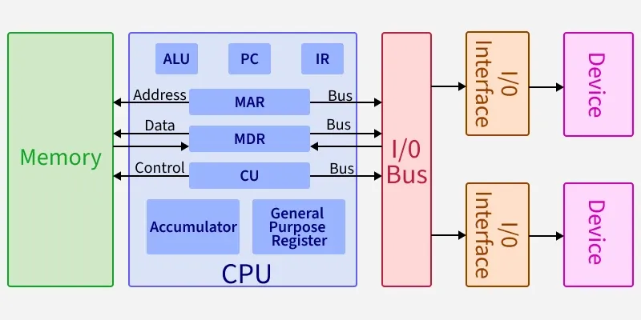
Lecture
SLIDE 5 / 14
Unified Memory Concept
1
Instructions and data share the same physical memory location space.
2
The CPU cannot access both simultaneously due to the single bus.
3
Memory addresses are used to locate both code and variables.
4
This simplifies hardware design but limits parallel processing capabilities.
5
The fetch-decode-execute cycle relies on this shared storage model.
6
No separate address buses exist for instructions versus data.
Von Neumann Architecture - GeeksforGeeks (source: media.geeksforgeeks.org)
Chandigarh University
5 / 14
Notes:
In this architecture, instructions and data share the same physical memory location space. The CPU cannot access both simultaneously because of the single bus constraint. Memory addresses are used to locate both code and variables without distinction. This simplifies hardware design but significantly limits parallel processing capabilities compared to other architectures.

Slide 6
Lecture
SLIDE 6 / 14
The Von-Neuman Bottleneck
1
The CPU speed exceeds the memory access speed significantly.
2
The processor often waits for data to be fetched from memory.
3
This waiting period creates a performance bottleneck known as the Von-Neuman bottleneck.
4
The bottleneck limits the overall system throughput regardless of CPU speed.
5
Modern solutions include caching to mitigate this specific register-memory delay.
6
The bottleneck is most visible during heavy data-intensive register operations.
Chandigarh University
6 / 14
Notes:
The CPU speed often exceeds the memory access speed significantly, creating a major issue. The processor frequently waits for data to be fetched from memory, causing idle time. This waiting period creates a performance bottleneck known as the Von-Neuman bottleneck. Consequently, the bottleneck limits the overall system throughput regardless of how fast the CPU is.

Slide 7
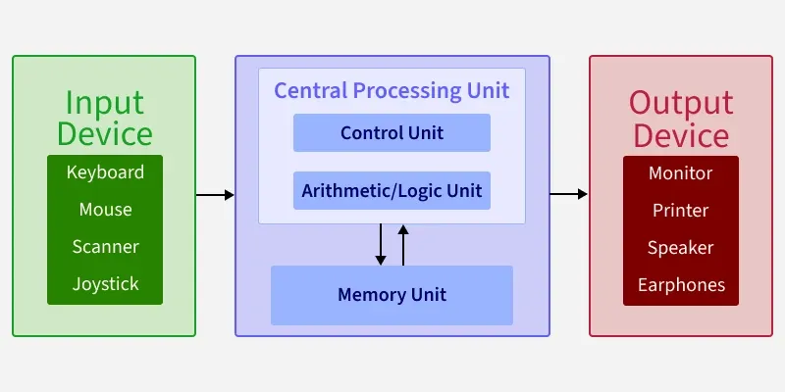
Lecture
SLIDE 7 / 14
Instruction Fetch Cycle
1
The Program Counter holds the address of the current instruction.
2
The address is placed on the address bus to request data.
3
The memory unit retrieves the instruction and places it on the data bus.
4
The instruction register loads the fetched instruction for decoding.
5
The Program Counter increments to point to the next instruction.
6
This cycle repeats continuously for every instruction execution.
Von Neumann Architecture - GeeksforGeeks (source: media.geeksforgeeks.org)
Chandigarh University
7 / 14
Notes:
The Program Counter holds the address of the current instruction, initiating the fetch cycle. The address is placed on the address bus to request the specific data from memory. The memory unit retrieves the instruction and places it on the data bus for the CPU. The instruction register then loads the fetched instruction for decoding, while the Program Counter increments.

Slide 8
Lecture
SLIDE 8 / 14
Data Execution Cycle
1
The decoded instruction specifies the operation and data operands.
2
Operands are fetched from memory or registers into the ALU.
3
The ALU performs the arithmetic or logical operation on the data.
4
The result is stored back into a register or memory location.
5
This cycle completes the execution of a single machine instruction.
6
Register organization determines the speed of operand availability.
Von Neumann Architecture - GeeksforGeeks (source: media.geeksforgeeks.org)
Chandigarh University
8 / 14
Notes:
The decoded instruction specifies the operation and the data operands required for execution. Operands are fetched from memory or registers into the ALU for processing. The ALU performs the arithmetic or logical operation on the data provided. The result is then stored back into a register or memory location, completing the execution.

Slide 9
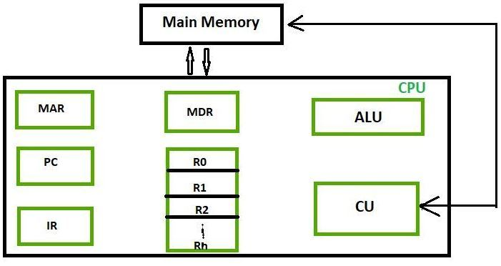
Lecture
SLIDE 9 / 14
Register Organization Role
1
Registers provide the fastest storage for immediate CPU operations.
2
The number of registers affects the complexity of the instruction set.
3
More registers reduce the need for frequent memory accesses.
4
General-purpose registers hold data during intermediate calculation steps.
5
Special registers like PC and IR manage control flow and state.
6
Efficient register allocation is critical for performance optimization.
Source: media.geeksforgeeks.org
Chandigarh University
9 / 14
Notes:
Registers provide the fastest storage for immediate CPU operations within this architecture. The number of registers directly affects the complexity of the instruction set and performance. More registers reduce the need for frequent memory accesses, which is a key optimization. General-purpose registers hold data during intermediate calculation steps, while special registers manage control flow.

Slide 10
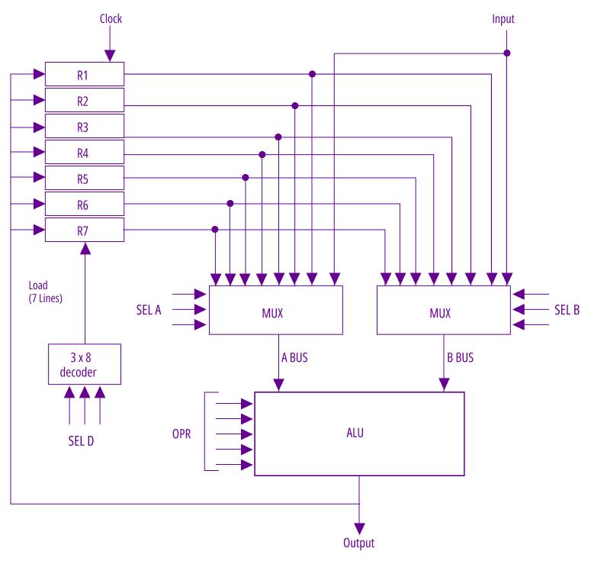
Lecture
SLIDE 10 / 14
Worked Numerical Example
GOVERNING EQUATION
Time = (0.5 × 100) + (0.5 × (100 + 1000)) = 600 cycles
1
Assume a CPU with 100 cycles per instruction and 1000 cycles memory access.
2
If 50% of instructions require data fetch, average time per instruction is calculated.
3
Without registers, every operation would require a full memory access.
4
With registers, only 50% of operations incur the memory penalty.
5
This demonstrates the performance gain from efficient register usage.
Source: d14qv6cm1t62pm.cloudfront.net
Chandigarh University
10 / 14
Notes:
Let's look at a numerical example to see the impact. Assume a CPU with 100 cycles per instruction and a 1000 cycle memory access time. If 50% of instructions require data fetch, the average time per instruction is calculated as 600 cycles. Without registers, every operation would require a full memory access, drastically slowing the system. This demonstrates the significant performance gain from efficient register usage.

Slide 11

Lecture
SLIDE 11 / 14
Common Pitfalls Analysis
1
Students often confuse Von-Neuman with Harvard architecture structures.
2
Assuming simultaneous instruction and data access is possible in this model.
3
Overlooking the role of the Program Counter in sequential execution.
4
Ignoring the impact of register size on addressable memory space.
5
Failing to distinguish between register transfer and memory transfer.
6
Misinterpreting the shared bus as a high-speed parallel link.
Source: i.redd.it
Chandigarh University
11 / 14
Notes:
A common pitfall is confusing Von-Neuman with Harvard architecture structures, which have separate buses. Students often assume simultaneous instruction and data access is possible in this model, which is incorrect. Another error is overlooking the role of the Program Counter in sequential execution. It is also crucial not to ignore the impact of register size on addressable memory space.

Slide 12
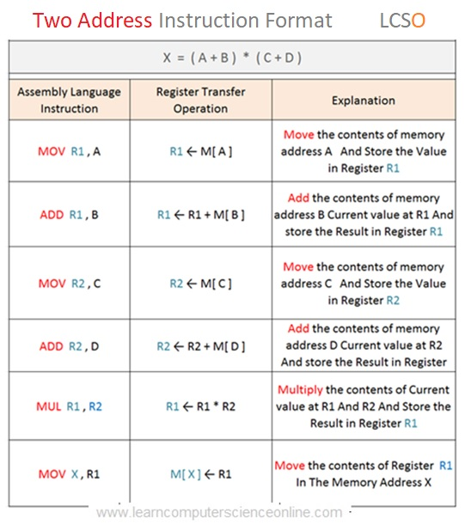
Lecture
SLIDE 12 / 14
Impact on Instruction Set
1
The architecture influences the design of addressing modes.
2
Instructions must explicitly specify memory or register operands.
3
Complex addressing modes increase the instruction fetch overhead.
4
Simple instructions are preferred to minimize bus contention.
5
The instruction set must support efficient register-to-register operations.
6
Designers balance complexity with the need to reduce memory traffic.
Source: www.learncomputerscienceonline.com
Chandigarh University
12 / 14
Notes:
The architecture significantly influences the design of addressing modes within the instruction set. Instructions must explicitly specify whether operands are in memory or registers. Complex addressing modes increase the instruction fetch overhead due to the shared bus. Designers balance complexity with the need to reduce memory traffic by favoring simple instructions.

Slide 13
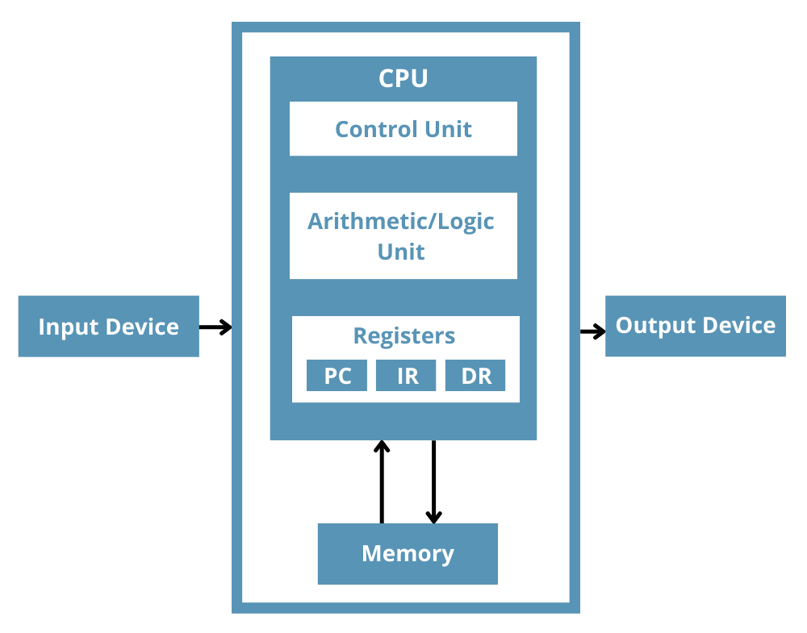
Lecture
SLIDE 13 / 14
Key Takeaways
1
Von-Neuman architecture uses a single shared bus for all transfers.
2
Memory stores both instructions and data in a unified space.
3
The Von-Neuman bottleneck limits performance due to sequential access.
4
Registers are critical for reducing memory access frequency.
5
Understanding this architecture is essential for analyzing ISAs.
Source: www.totalphase.com
Chandigarh University
13 / 14
Notes:
To summarize, Von-Neuman architecture uses a single shared bus for all transfers. Memory stores both instructions and data in a unified space, creating a sequential access requirement. The Von-Neuman bottleneck limits performance due to this sequential access nature. Registers are critical for reducing memory access frequency, and understanding this is essential for analyzing ISAs.

Slide 14
Lecture
SLIDE 14 / 14
References
COMPUTER ORGANIZATION AND DESIGN
The Hardware/Software Interface — David A. Patterson, John L. Hennessy
COMPUTER ARCHITECTURE
A Quantitative Approach — John L. Hennessy, David A. Patterson
• Computer Organization and Architecture — William Stallings
• Computer System Architecture — M. Morris Mano & Rajib Mall
• Computer Organization — Carl Hamacher, Zvonko Vranesic, Safwat Zaky
Chandigarh University
14 / 14
Notes:
For further reading, please refer to the standard textbooks listed on this slide. William Stallings and M. Morris Mano provide excellent foundational coverage of these concepts. David A. Patterson and John L. Hennessy offer deep insights into the hardware-software interface. These resources will help you deepen your understanding of register organization and architecture.

